Slide 1
Machine Learning
Machine Learning Introduction to Machine Learning by Kumar Anurupam is licensed under a Creative Commons Attribution-4.0 International License.
Artificial Neural Networks – MLP Memoization, Backpropagation
CS 3104 Fall 2019
Lecture Slides by Kumar Anurupam

Slide 2
Learning Objectives
After completion of today’s session you will be able to:
Describe the use of Memoization.
Illustrate the algorithm of Backpropagation.

Slide 3
Memoization
In computing, memoization is an optimization technique used primarily to speed up computer programs by storing the results of expensive function calls and returning the cached result when the same inputs occur again
It follows the idea of:
Compute once
Store the results
Reuse the stored results
It can be used in the backpropagation algorithm to speed up the process by taking slightly more memory.

Slide 4
Feedforward Neural Network
The feedforward neural network was the first and simplest type of artificial neural network devised.
A multilayer feedforward neural network is an interconnection of perceptrons in which data and calculations flow in a single direction which is forward, from the input nodes, through the hidden nodes (if any) and to the output nodes.
A feedforward neural network is an artificial neural network wherein connections between the nodes do not form a cycle.

Slide 5
Backpropagation
Backpropagation, short for "backward propagation of errors," algorithms are a family of methods used to efficiently train artificial neural networks (ANNs) following a gradient-based optimization algorithm that uses the chain rule and memoization.
It is a supervised learning algorithm.
The main feature of backpropagation is its iterative, recursive and efficient method for calculating the weights updates to improve the network until it is able to perform the task for which it is being trained.
Given an artificial neural network and an error function, the method calculates the gradient of the error function with respect to the neural network's weights.
It is a generalization of the delta rule for perceptrons to multilayer feedforward neural networks.

Slide 6
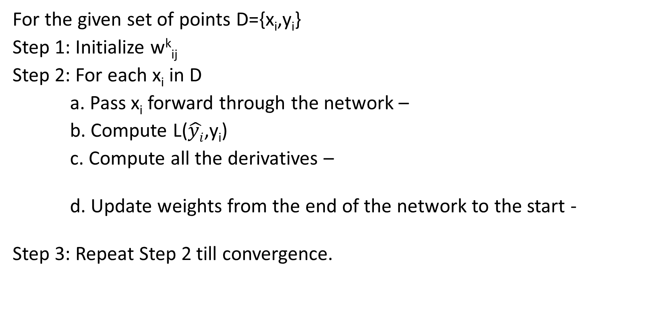
Backpropagation Algorithm
For the given set of points D={x_{i},y_{i}}
Step 1: Initialize w^{k}_{ij}
Step 2: For each x_{i} in D
a. Pass x_{i} forward through the network –
b. Compute L($\hat{yi}$,y_{i})
c. Compute all the derivatives –
d. Update weights from the end of the network to the start -
Step 3: Repeat Step 2 till convergence.
Feed forwarding
Epoch
Using Chain Rule and Memoization
Backpropagation
That is, (w^{k}_{ij})_{new} ≈ (w^{k}_{ij})_{old}

Slide 7
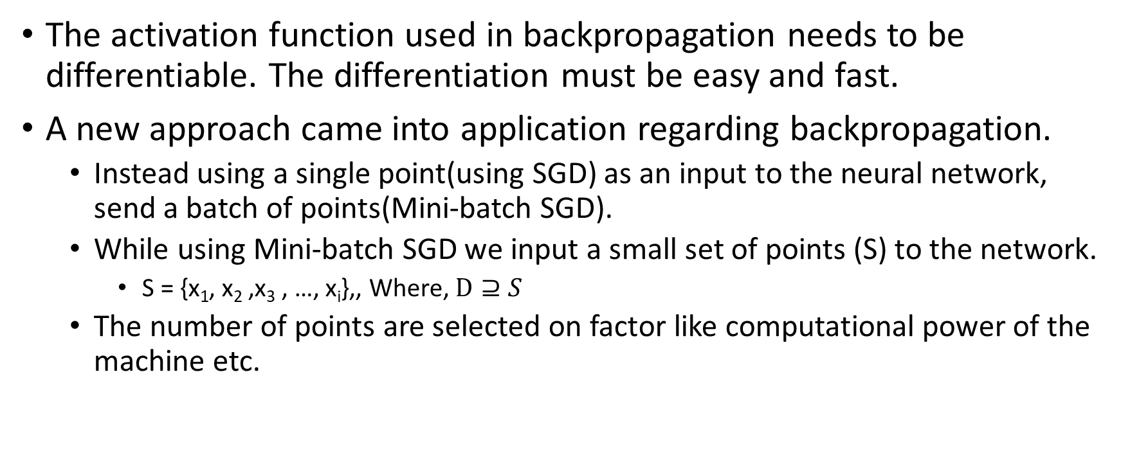
Important points in Backpropagation
The activation function used in backpropagation needs to be differentiable. The differentiation must be easy and fast.
A new approach came into application regarding backpropagation.
Instead using a single point(using SGD) as an input to the neural network, send a batch of points(Mini-batch SGD).
While using Mini-batch SGD we input a small set of points (S) to the network.
S = {x₁, x₂ ,x₃ , …, x_{i}},, Where, $D⊇S$
The number of points are selected on factor like computational power of the machine etc.

Slide 8

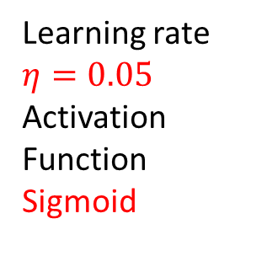
Solve the following problem using Backpropagation algorithm
Input Layer
Hidden Layer
Output Layer
X_{i1}
0.11
f₁₁
2
0.14
0.12
y_{i} = 1
Learning rate
$$η=0.05$$
Activation Function
Sigmoid
f₂₁
$\hat{y}$_{i}
0.21
Output
0.15
X_{i2}
f₁₂
3
0.08
0.60
0.35
1
1
Bias(b₁)
Bias(b₂)

Slide 9
References
[1] https://docs.roguewave.com/imsl/c/6.0/stat/default.htm?turl=multilayerfeedforwardneuralnetworks.htm
[2] https://en.wikipedia.org/wiki/Feedforward_neural_network
[3] https://en.wikipedia.org/wiki/Backpropagation
[4] https://brilliant.org/wiki/backpropagation/

Slide 10
Thanks

